Slide 1
Multiple-instance Weakly Supervised Object Localization
Thesis – 29/6/2023
Geert Goemaere

Slide 2
Content
Introduction
Research question
Methodology
Experiments
Conclusions
Notes:
Time:
10’ introduction + research method + methodology
10’ experiments + conclusions

Slide 3
Introduction

Slide 4

Multiple-instance WSOL
WSOL
Multiple-instance WSOL
Notes:
The research topic of this thesis is called “multiple-instance weakly supervised object localization” (multiple-instance WSOL).
So, let’s first explain where in the object recognition landscape whe can situate multi-instance WSOL by looking at different tasks in this picture.
Image classification deals with assigning a single label or category) to an image. Here the label is CAT.
Object localization deals with localizing objects in an image by indicating their bounding box. In the case of WSOL, only a single object is localized by training a model with class labels only.
Object detection is the task of locating objects in an image with bounding boxes and assigning a class label for each detection.
Instance segmentation deals with assigning a class label for each pixel of an image.
Just as WSOL, multi-instance WSOL uses only class labels to train a model for localization, but it extends WSOL to find mutiple objects of the same class.

Slide 5
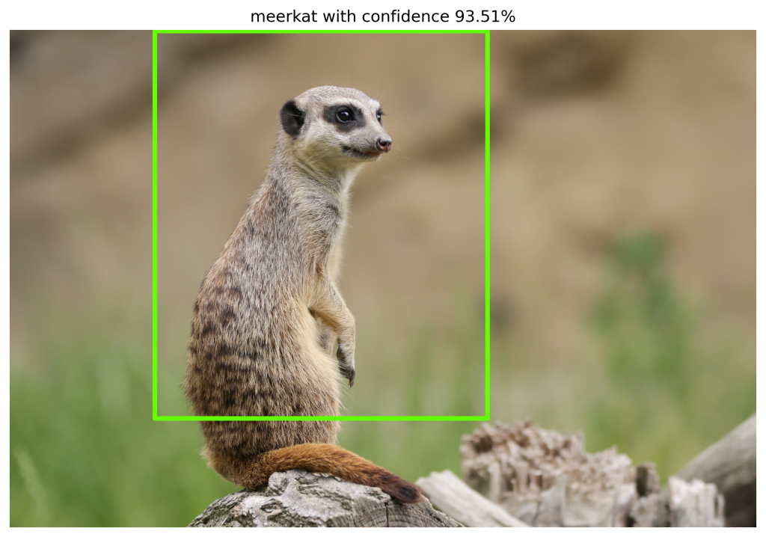
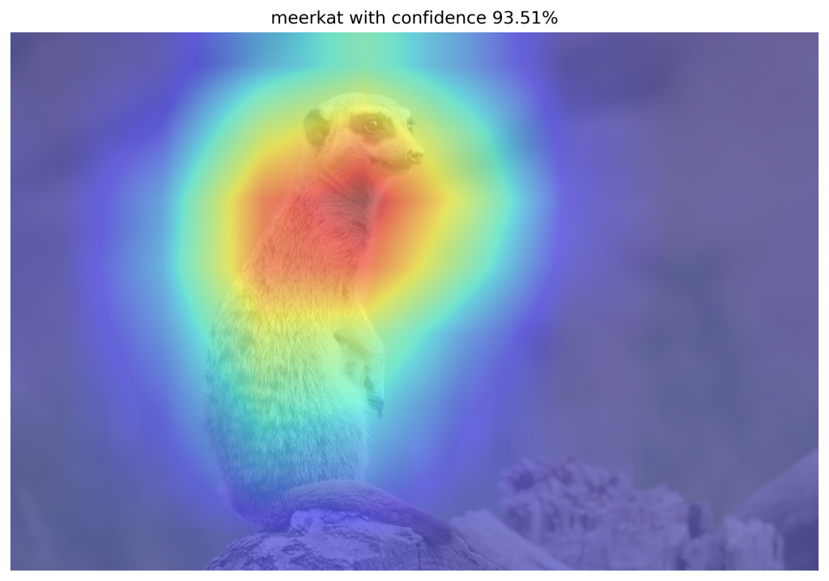
WSOL
CAM-based WSOL methods
Class Activation Mapping (CAM)
Focus on discriminative features related to target
Activated features used to localize object
CAM-based techniques to improve CAM
Grad-CAM, Grad-CAM++, Score-CAM, MinMaxCAM
Problem
Assumption of single image-level class
Multiple-instance localization hasn’t been tested in prior-art

Slide 6
Research question

Slide 7
Research question
Can we use CAM-based methods to evaluate and improve
localization of multiple object instances of the same class
within images for the WSOL task?

Slide 8
Research question - contributions
Can we use CAM-based methods to evaluate and improve
localization of multiple object instances of the same class
within images for the WSOL task?
protocol
Iterative localization
Synthetic dataset

Slide 9
Methodology
Multiple-instance WSOL

Slide 10
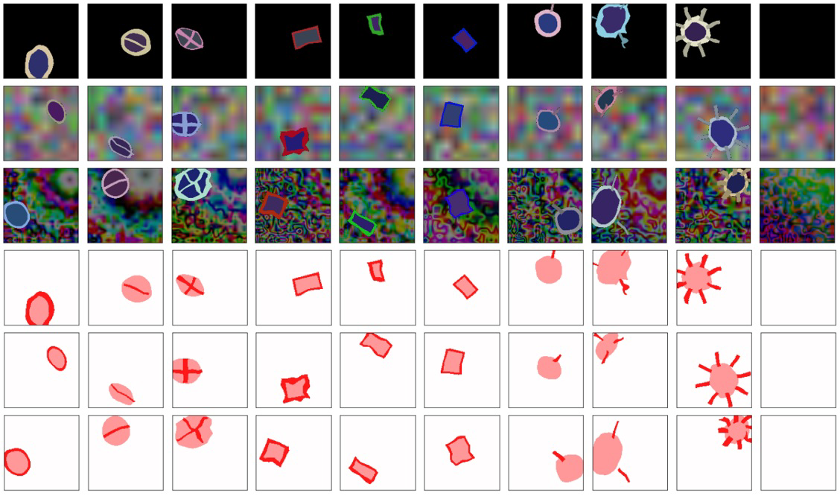
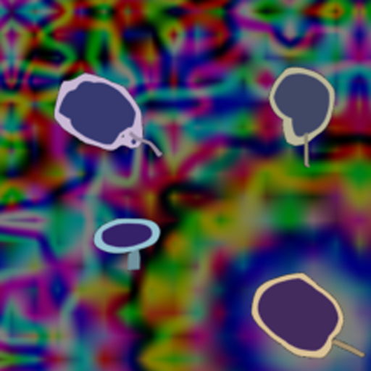
Synthetic datasets
Synthetic dataset [Tjoa, E. et al.]
Single instance, 10 classes
GT: image-level class, segmentation mask
Multiple-instance datasets
Control over instances, structure, ground truth
Multiple instances, single class
8 datasets: d<1..4><b|t> (1000/200/200)
d3b: images with 3 object instances on background (b)
d2t: images with 2 object instances on transparent (t) background
GT: image-level class, segmentation mask, bounding boxes

Slide 11
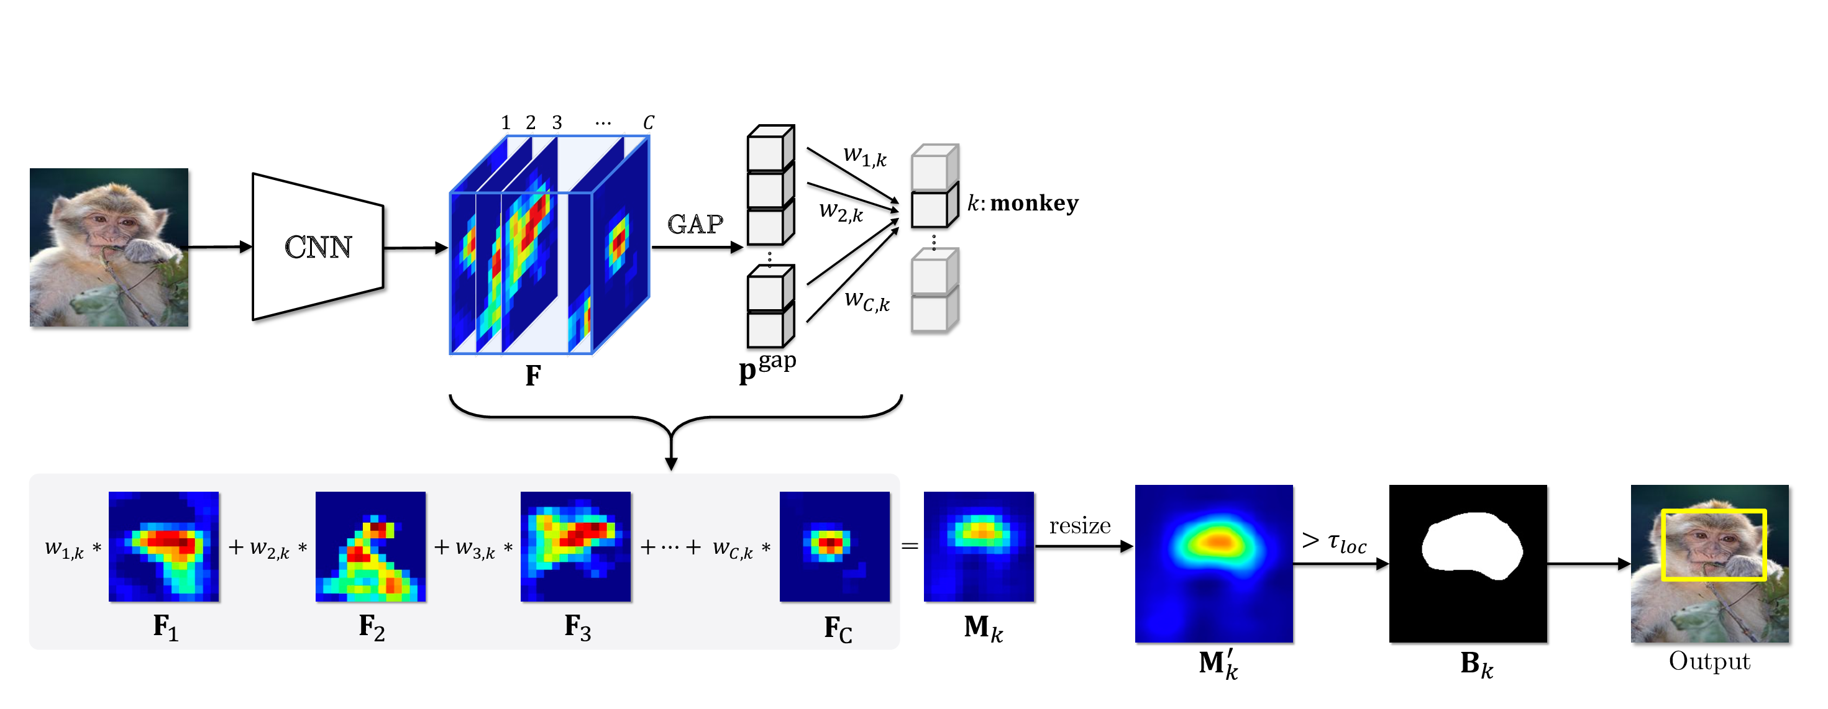
CAM-based WSOL
Notes:
Classifier is trained using image-level class labels
Activation map = weighted (*) combination of feature maps
Binary mask = Activation map > threshold 𝛕
Predicted bounding boxes are computed from contours in binary mask
(*) Weight computation is specific to CAM-based method

Slide 12
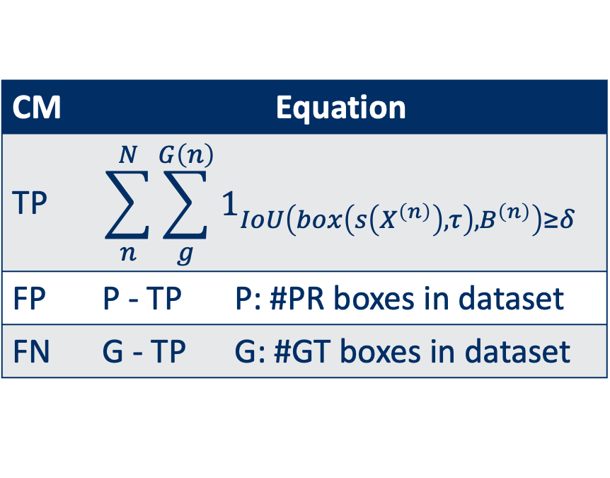
Multiple-instance localization metrics
Problem
No existing multiple-instance WSOL metrics
GT₁
GT₂
CM | Equation
TP | $$\sum_{n}^{N}{\sum_{g}^{G\left(n\right)}{1_{IoU\left(box\left(s\left(X^{\left(n\right)}\right),τ\right),B^{\left(n\right)}\right)≥δ}}}$$
FP | P - TP | P: #PR boxes in dataset
FN | G - TP | G: #GT boxes in dataset
PR₁
PR₂
GT₃
GT₄
PR₃

Slide 13
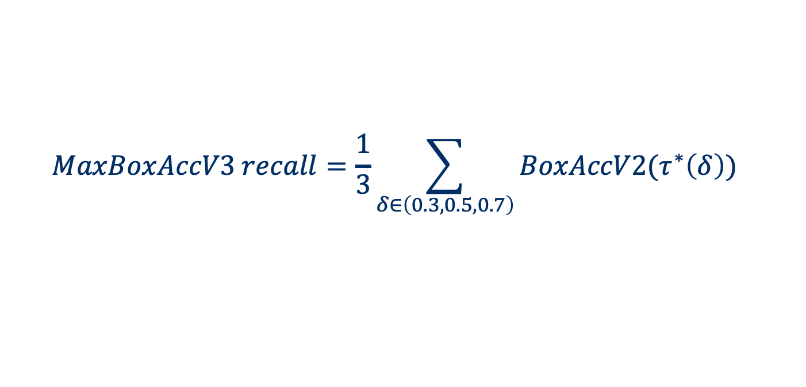
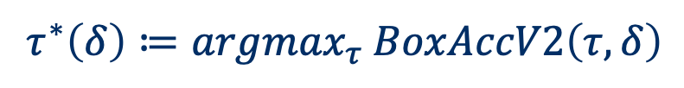
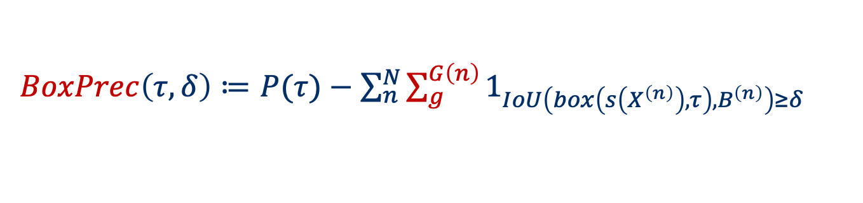
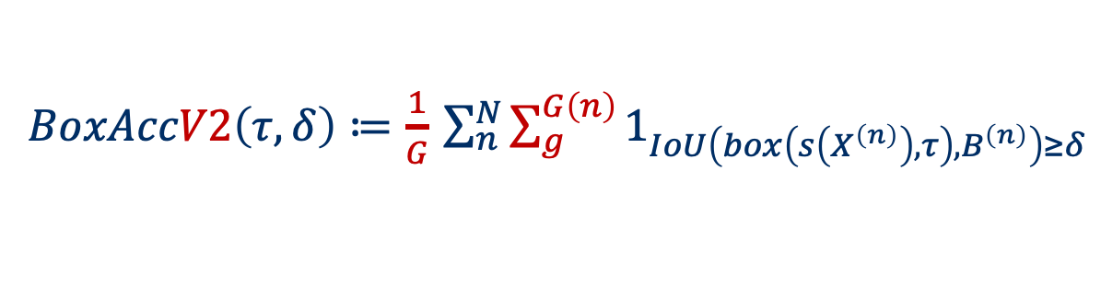
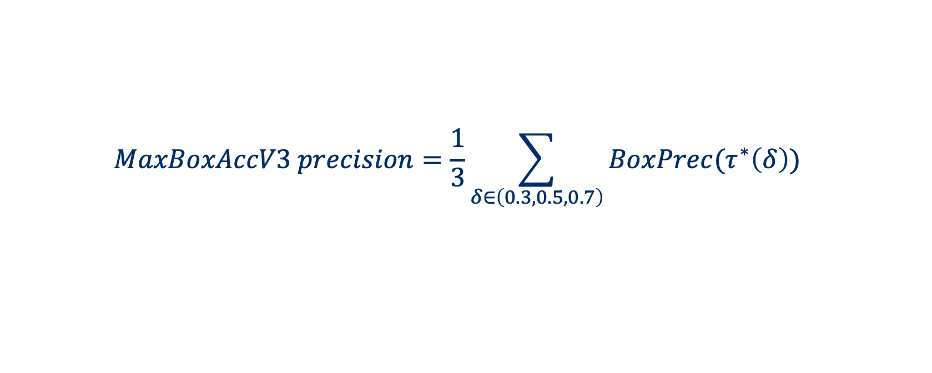
Metrics – MaxBoxAccV3 (derived from Choe et al.)
TP
Recall:
$BoxAccV2\left(τ,δ\right)≔\frac{1}{G}$ $\sum_{n}^{N}{\sum_{g}^{G\left(n\right)}{1_{IoU\left(box\left(s\left(X^{\left(n\right)}\right),τ\right),B^{\left(n\right)}\right)≥δ}}}$
Precision:
$BoxPrec\left(τ,δ\right)≔$ $P(τ)−\sum_{n}^{N}{\sum_{g}^{G\left(n\right)}{1_{IoU\left(box\left(s\left(X^{\left(n\right)}\right),τ\right),B^{\left(n\right)}\right)≥δ}}}$
Optimal threshold:
$$τ^{∗}\left(δ\right)≔{argmax}_{τ} BoxAccV2\left(τ,δ\right)$$
$$MaxBoxAccV3 recall=\frac{1}{3}\sum_{δ∈\left(0.3,0.5,0.7\right)}{BoxAccV2(τ^{∗}\left(δ\right))}$$
$$MaxBoxAccV3 precision=\frac{1}{3}\sum_{δ∈\left(0.3,0.5,0.7\right)}{BoxPrec(τ^{∗}\left(δ\right))}$$
Notes:
Remark: discuss difference with BoxAcc and why BoxAcc is not applicable for multi-instance localization.

Slide 14
Localization improvement
Problem
WSOL task trained for classification
Activation of discriminative features
Not equally strong on all objects
Not all objects localized
Notes:
Remarks:
Toon image waarbij enkel discriminatieve features highlighted zijn.
Visueel aantonen hoe iteratieve localizatie werkt

Slide 15
Iterative localization – oracle based masking
Notes:
An image is fed to the network model, and a score map is computed using a CAM-based method.
Bounding boxes are computed from the score map using various score map thresholds. Here boxes are show at the optimal threshold (MaxBoxAccV3 recall)
Oracle method: Image is masked with bounding boxes at optimal threshold (computed using GT information). Here the mask is filled with random values from image distribution in dataset.
Masked image is fed to network again, and process repeats until stop criterion is met (max iteration count or drop in prediction score higher than threshold)
Here: bbox merge strategy is ‘add’.

Slide 16
Iterative localization – score map based masking
Notes:
An image is fed to the network model, and a score map is computed using a CAM-based method.
Bounding boxes are computed from the score map using various score map thresholds. Here boxes are shown at the optimal threshold (MaxBoxAccV3 recall)
Score map method: Image is masked with score map at threshold equal to mean score map value. Here the mask is filled with random values from image distribution in dataset.
Masked image is fed to network again, and process repeats until stop criterion is met (max iteration count or drop in prediction score higher than threshold)
Here: bbox merge strategy is ‘add’.

Slide 17
Experiments

Slide 18
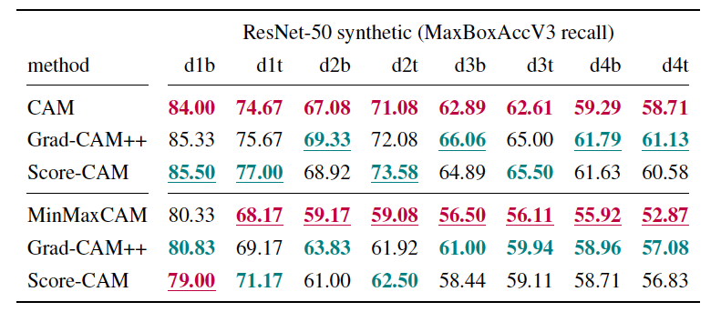
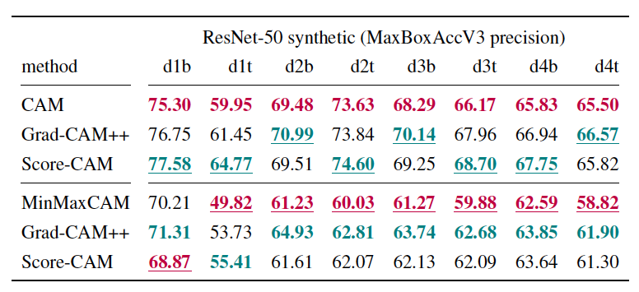
Localization: ResNet-50 - Synthetic datasets
Notes:
Trends
By colour:
Best: Grad-CAM++ in nearly all datasets and for both non-regularized and MinMaxCAM-regularized ResNet-50 network
Worst: CAM
By instance count:
Localization performance (precision/recall) decreases as number of object instances increases in images
By regularization (b/t variant discrepancy in MinMaxCAM regularized case):
Wang et al. [14] set out, the condition for common region regularization to work, is that a set of images for the same class should have different backgrounds. This clearly is not the case for
the t-variant datasets.

Slide 19
Localization: ResNet-50 - Synthetic datasets
MinMaxCAM
Notes:
By method
Grad-CAM++ best, Score-CAM worst
By regularization
- MinMaxCAM worse than non-regularized (not show at same threshold)

Slide 20
Localization: ResNet-50 - Synthetic datasets
MinMaxCAM
Notes:
By method
Grad-CAM++ best, Score-CAM worst
By regularization
- MinMaxCAM worse than non-regularized (not show at same threshold)

Slide 21
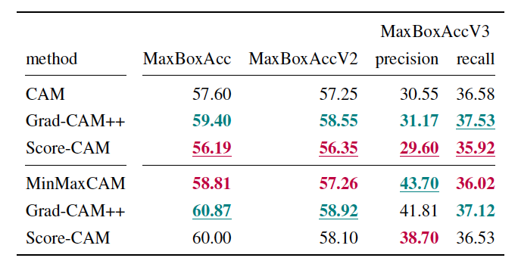
Localization: ResNet-50 - ImageNet
Notes:
Trends
By colour:
Best: Grad-CAM++ in nearly all datasets and for both non-regularized and MinMaxCAM-regularized ResNet-50 network
Worst: Score-CAM :
ImageNet is highly biased towards single-instance images, and Score-CAM doesn’t excel for single instance images.
By regularization:
Better recall scores for MinMaxCAM regularized scores for Score-CAM-based method, not for CAM and Grad-CAM++
Precision improves: less background activations due to CRR

Slide 22
Localization: ResNet-50 - ImageNet
Notes:
Regularization effect: less background activations.

Slide 23
Localization: ResNet-50 - ImageNet
Notes:
Regularization effect: less background activations.

Slide 24
Localization: ResNet-50 - ImageNet
Notes:
Regularization effect: less background activations.

Slide 25
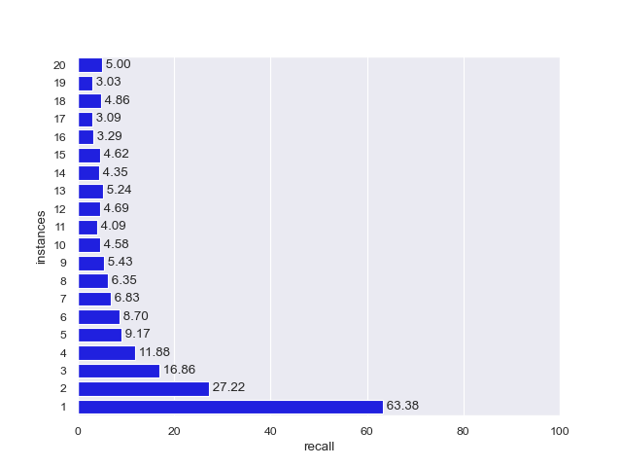
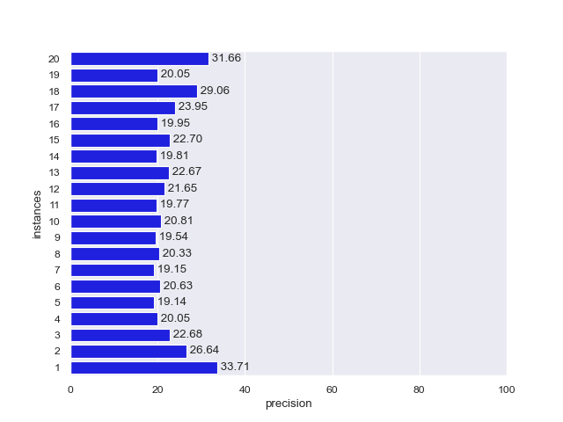
Localization: ResNet-50 - ImageNet
CAM - MaxBoxAccV3 recall: 36.58
CAM - MaxBoxAccV3 precision: 30.55
Notes:
Recall is highest for the single-instance dataset, and significantly drops significantly as more object instances are present in the images of a dataset.
For ImageNet datasets with eight or more instances, recall seems to be rather similar.
Overall recall for singe ImageNet dataset was: 0.38
We observed a similar pattern for the synthetic: recall decreases for images with more instances.

Slide 26
Iterative localization: ResNet-50 for synthetic d4b
Oracle-based image masking
Score map based image masking
Notes:
Left: oracle-based iterative localizaiton, right: score map based iterative localization.
4 plots, for CAM, Grad-CAM++, Score-CAM and MinMaxCAM-regularized evaluated using CAM.
Horizontal line: baseline precision, vertical line: baseline recall. -> 4 quadrants
Recall can be improved at cost of lower precision for all CAM-based methods (oracle and score map)
Mask strategy less important (more clustered per merge strategy)
Merge strategy important: add strategy best for recall, worst for precision
Grad-CAM++ and Score-CAM can obtain highest gain in recall
Score map results are lower than oracle results
Average score map value threshold less accurate than oracle threshold (GT)
Simple structure of synthetic datasets: cleanly separated instances
for the score map based approach are lower than the oracle based results. Intuitively, the average
score map value used as threshold to compute the score map mask, will be less accurate
Master’s thesis —85
CHAPTER 5. DISCUSSION
than the oracle base approach where ground truth information is used to compute the bounding
boxes mask.

Slide 27
Iterative localization: ResNet-50 – Synthetic (oracle)
Notes:
Qualitative examples

Slide 28
Iterative localization: ResNet-50 – Synthetic (score map)
Notes:
Qualitative examples

Slide 29
Iterative localization: ResNet-50 for ImageNet
Notes:
Discuss trends:
Recall increases, precision drops
Mask strategy less important
Merge strategy important
Recall trend score map approach higher than oracle-based approach
In contrast with synthetic datasets
Intuition:
ImageNet more complex structure: No clean separationof object instances
Very diverse set of images.
Bounding box masks: Optimal threshold is tuned towards maximizing matches with GT

Slide 30
Iterative localization: ResNet-50 – ImageNet (oracle)

Slide 31
Iterative localization: ResNet-50 – ImageNet (score map)

Slide 32
Iterative localization: ResNet-50 – ImageNet (oracle)
Notes:
Qualitative example

Slide 33
Iterative localization: ResNet-50 – ImageNet (score map)
Notes:
Qualitative example

Slide 34
Iterative localization: ResNet-50 – ImageNet (oracle)
Notes:
Qualitative example

Slide 35
Iterative localization: ResNet-50 – ImageNet (oracle)
Notes:
Qualitative example

Slide 36
Conclusions

Slide 37
Conclusions
We defined multiple-instance WSOL metrics precision and recall
Validated for synthetic and ImageNet on VGG16 and ResNet-50
Localization performance is correlated with number of object instances
Localization improvement using iterative localization
Mask images with objects location from previous iteration to find new objects
Score map vs oracle masking: Different results for ImageNet and synthetic
Localization recall can be improved at cost of precision
Bounding box merge strategy is most important factor
CAM-based methods can be used to improve MWSOL task

Slide 38



Slide 39
Backup

Slide 40
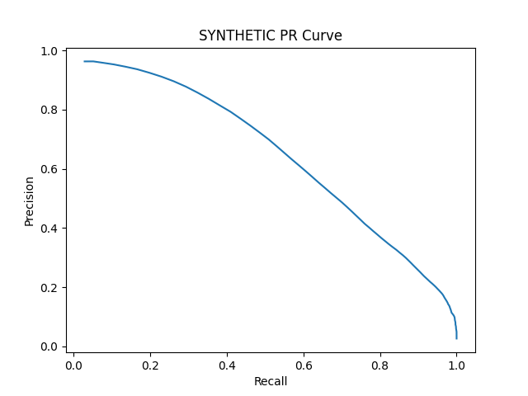
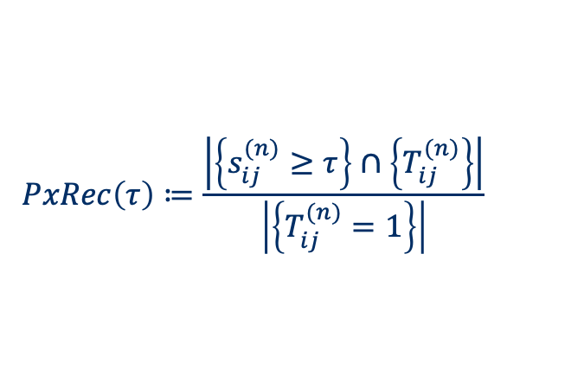
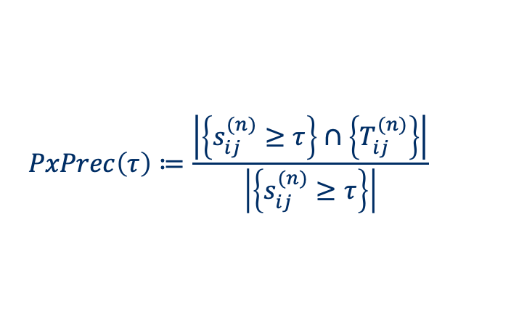
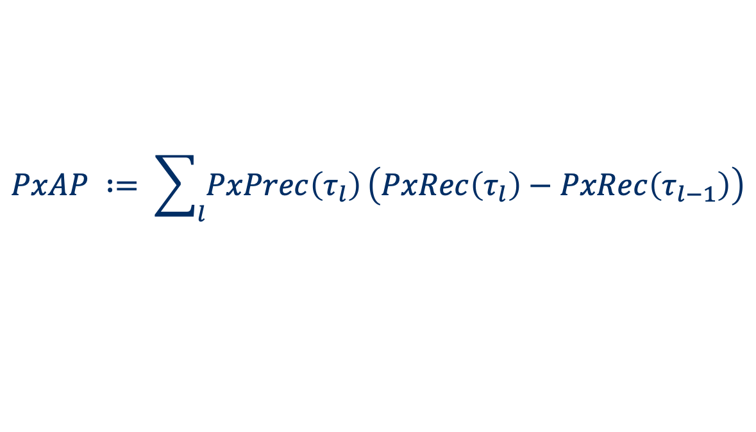
Metrics – Pixel Average Precision (PxAP)
PxAP already used in [Choe et al., 2020b]
Applies to multi-instance localization
Only usable when GT segmentation masks available
$$PxPrec\left(τ\right)≔\frac{\left|\left\{s_{ij}^{(n)}≥τ\right\}\right.∩\left.\left\{T_{ij}^{(n)}\right\}\right|}{\left|\left\{s_{ij}^{(n)}≥τ\right\}\right|}$$
$$PxRec\left(τ\right)≔\frac{\left|\left\{s_{ij}^{(n)}≥τ\right\}\right.∩\left.\left\{T_{ij}^{(n)}\right\}\right|}{\left|\left\{T_{ij}^{(n)}=1\right\}\right|}$$
$$PxAP ∶= \sum_{l}{PxPrec\left(τ_{l}\right)}\left(PxRec\left(τ_{l}\right)−PxRec\left(τ_{l−1}\right)\right)$$
Notes:
Remark: keep as backup slide

Slide 41
Learning curves
Observations
Example: MinMaxCAM for VGG16-GAP SYNTHETIC
Best localization after few training epochs
Further classification training hurts localization
Focus on most discriminative parts
In line with Choe et al, 2020b findings

Slide 42
Box Accuracy at varying CAM thresholds (IOU 50)
Notes:
BoxAcc for 1, 2, 3, 4 instance datasets
1 instance: All CAM methods perform similarly, outperformed by ScoreCAM
2,3,4: ScoreCAM performance margin over others even more pronounced
Optimal CAM threshold similar for all methods

Slide 43
Precision-Recall at varying CAM thresholds
Notes:
PR-Curves at varying CAM thresholds:
Allows us to choose preferred operating thresholds that provides the best precision-recall trade-off
1 instance: similar performance for all methods
2,3,4 instance:
ScoreCAM outperforms rest
AUC drops significantly

